Slide 1

Learning Energy Efficient Jumping Strategies for Flexible-Legged Systems
Andrew Albright, Joshua Vaughan
Dept. of Mechanical Engineering
Univ. of Louisiana at Lafayette
andrew.albright@louisiana.edu, joshua.vaughan@louisiana.edu

Slide 2

Pros of Legged Robots
https://www.bostondynamics.com/atlas
Notes:
TODO:
Get citation

Slide 3

Cons of Legged Robots
Watch the Atlas Robot take a spill running parkour #shorts - YouTube

Slide 4
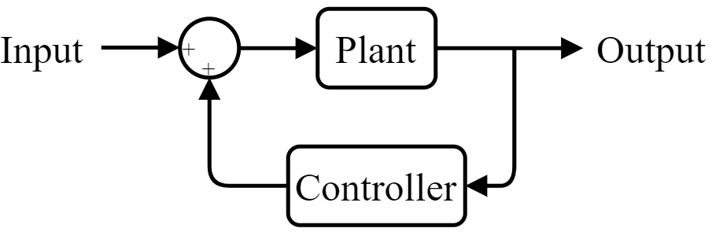
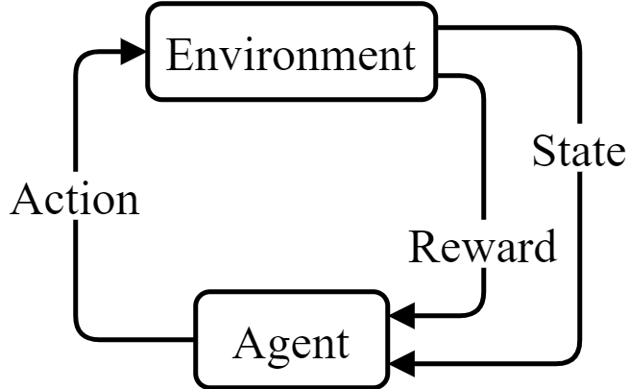
Control Methods
Traditional Controls Method
Reinforcement Learning Method
Notes:
TODO:
Make sure your traditional controls diagram is correct

Slide 5
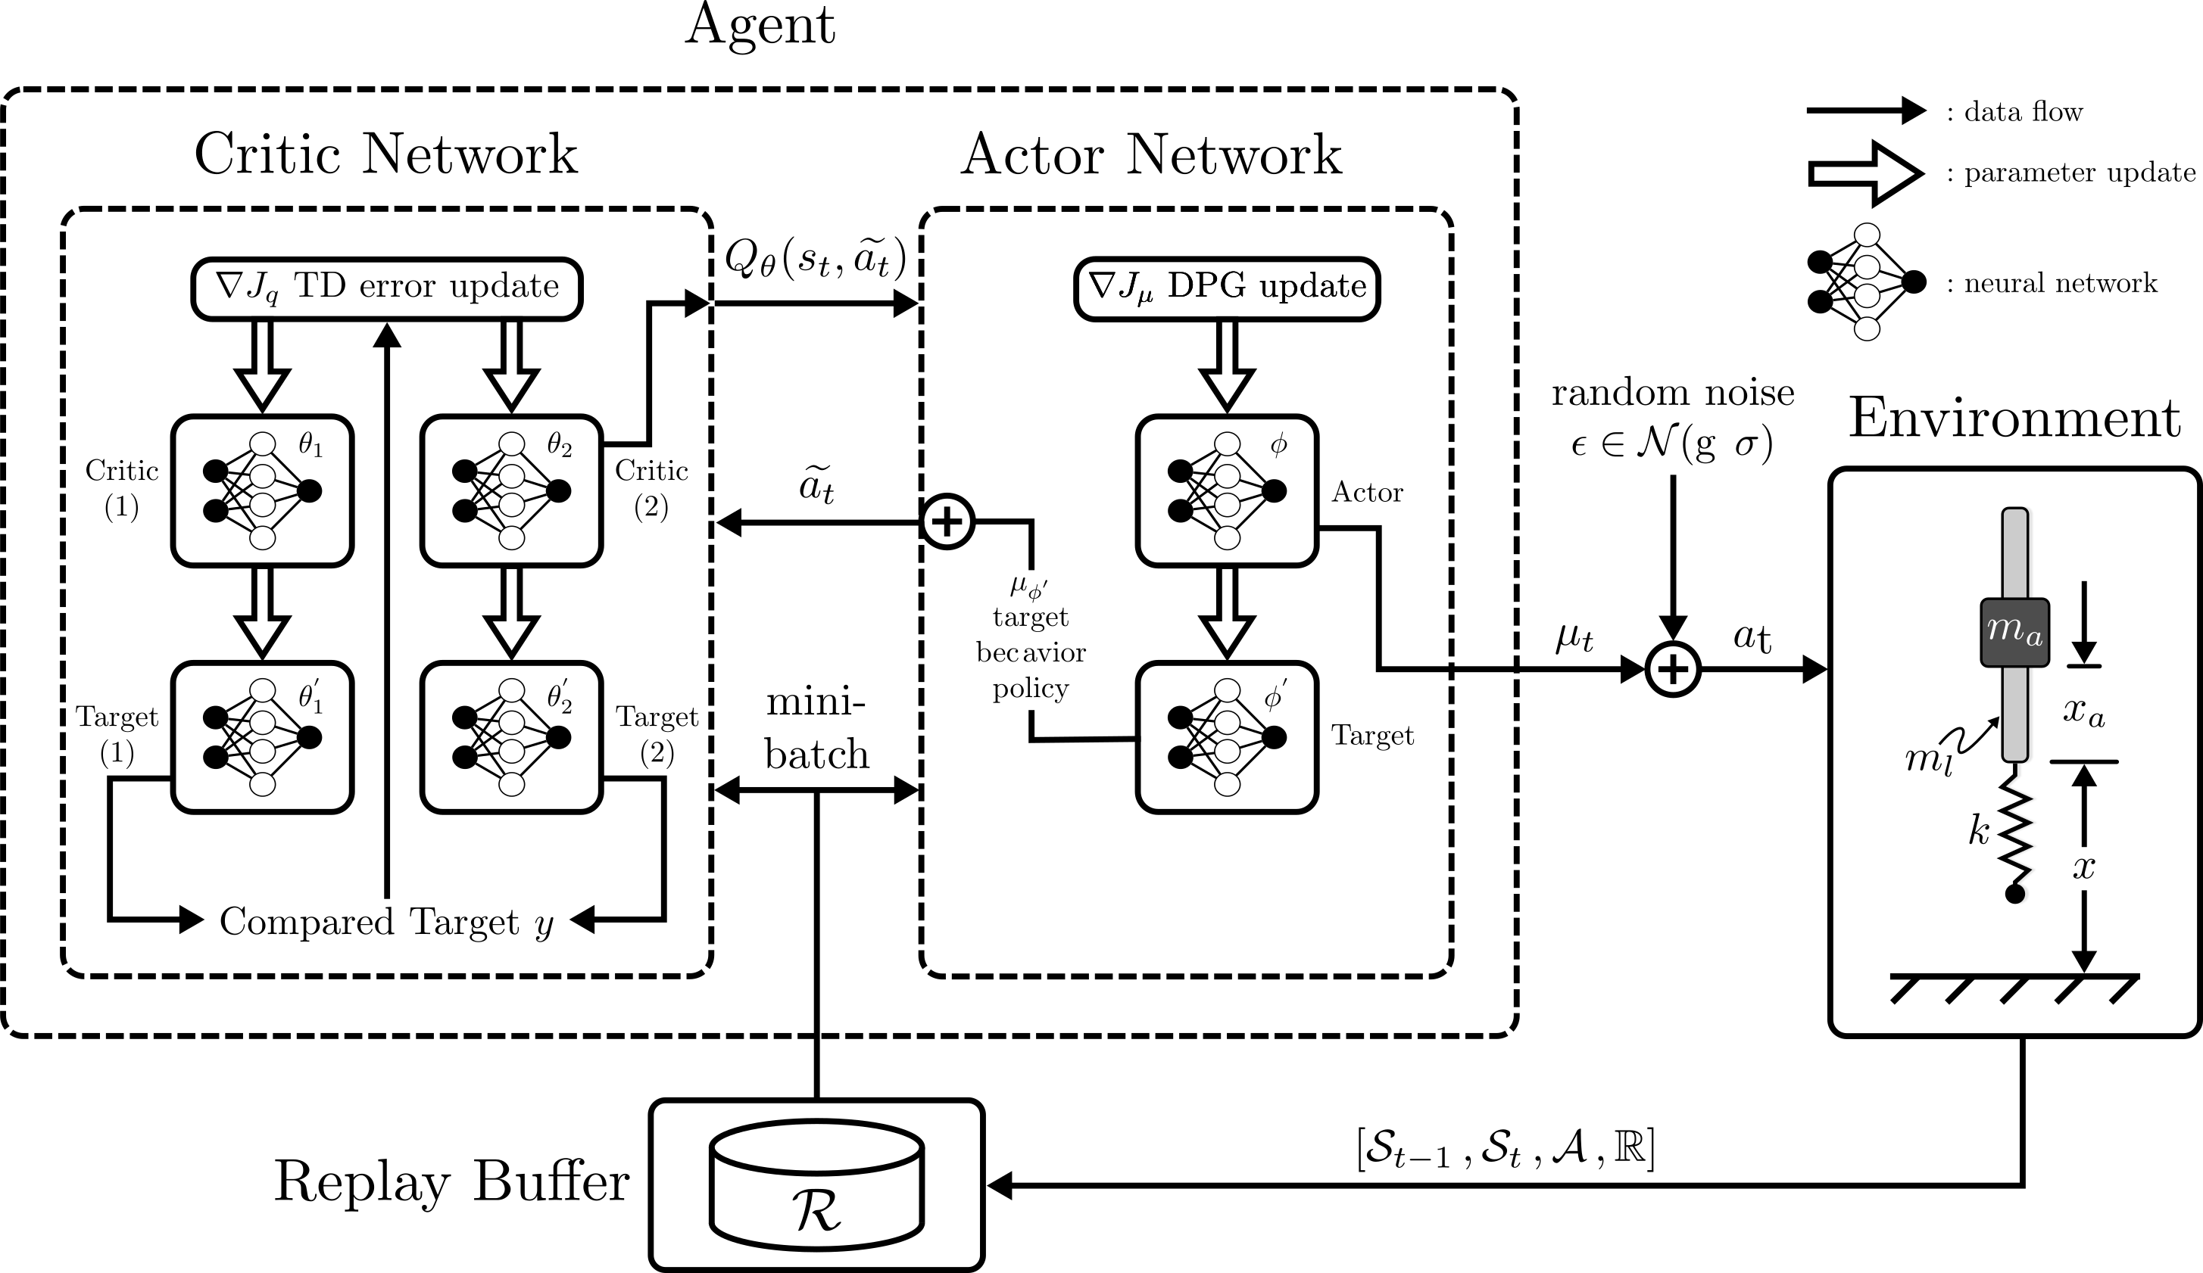
Algorithm Used – TD3
Structure of TD3 (Twin Delayed Deep Deterministic Policy Gradient) with... | Download Scientific Diagram (researchgate.net)
Notes:
Notes:
- Twin Delayed Deep Deterministic Policy Gradient
- Can only be used with environments containing continuous action spaces
- Off-policy learning algorithm
- Actor-Critic Algorithm
- Adds target policy smoothing
- Learns main Q-function (critic) using two target Q-functions simultaneously
- Updates the policy (actor), target policy and target Q-functions every two main Q-function updates

Slide 6
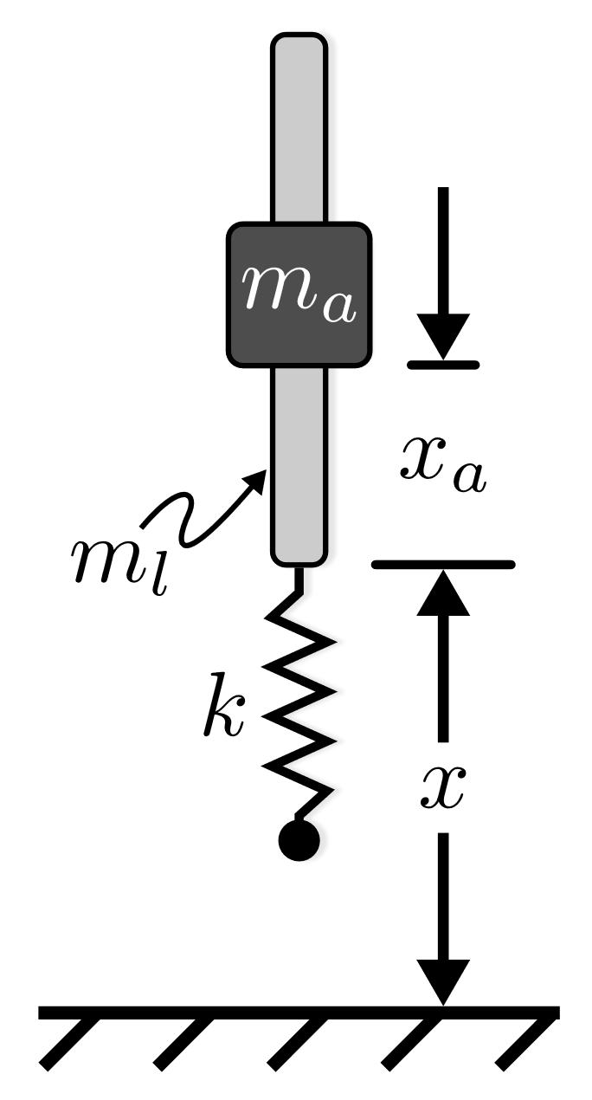
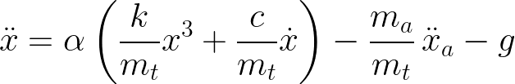
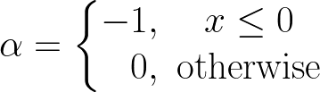
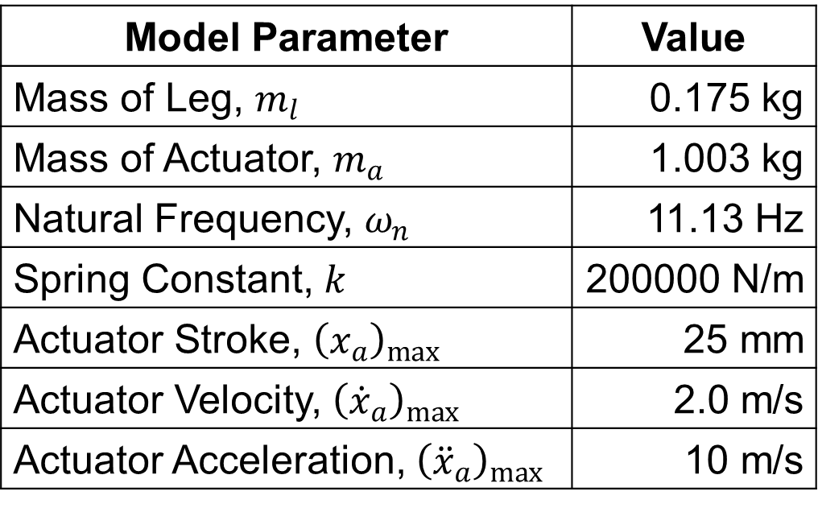
Flexible Jumping System
Model Parameter | Value
Mass of Leg, $m_{l}$ | 0.175 kg
Mass of Actuator, $m_{a}$ | 1.003 kg
Natural Frequency, $ω_{n}$ | 11.13 Hz
Spring Constant, $k$ | 200000 N/m
Actuator Stroke, ${\left(x_{a}\right)}_{max}$ | 25 mm
Actuator Velocity, ${\left({\dot{x}}_{a}\right)}_{max}$ | 2.0 m/s
Actuator Acceleration, ${\left({\ddot{x}}_{a}\right)}_{max}$ | 10 m/s
Notes:
TODO:
Consider making the plot in LaTeX

Slide 7


Environment Spaces

Slide 8
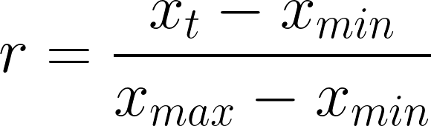
Reward Jumping High

Slide 9
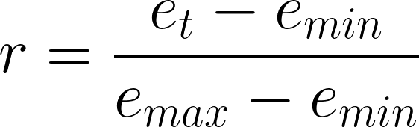

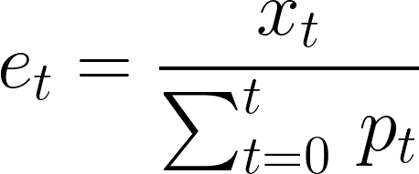

Reward Jumping Efficiently

Slide 10
Training Schedule
Task | Jump Type | # Agents | Network Seeds
Jump Hight | Stutter Jump | 10 | 9, 16, 104, 107, 250, 676, 868, 878, 918, 947
 | One Jump | 10
Conserve Power | Stutter Jump | 10
 | One Jump | 10

Slide 11
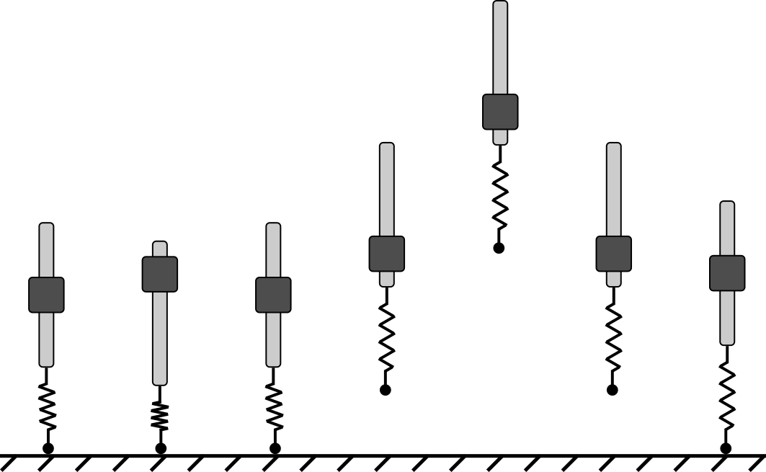
Single Jump
Notes:
Note:
Difference in timing for best agents
TODO:
What is a single jump?
Action? Observation?

Slide 12
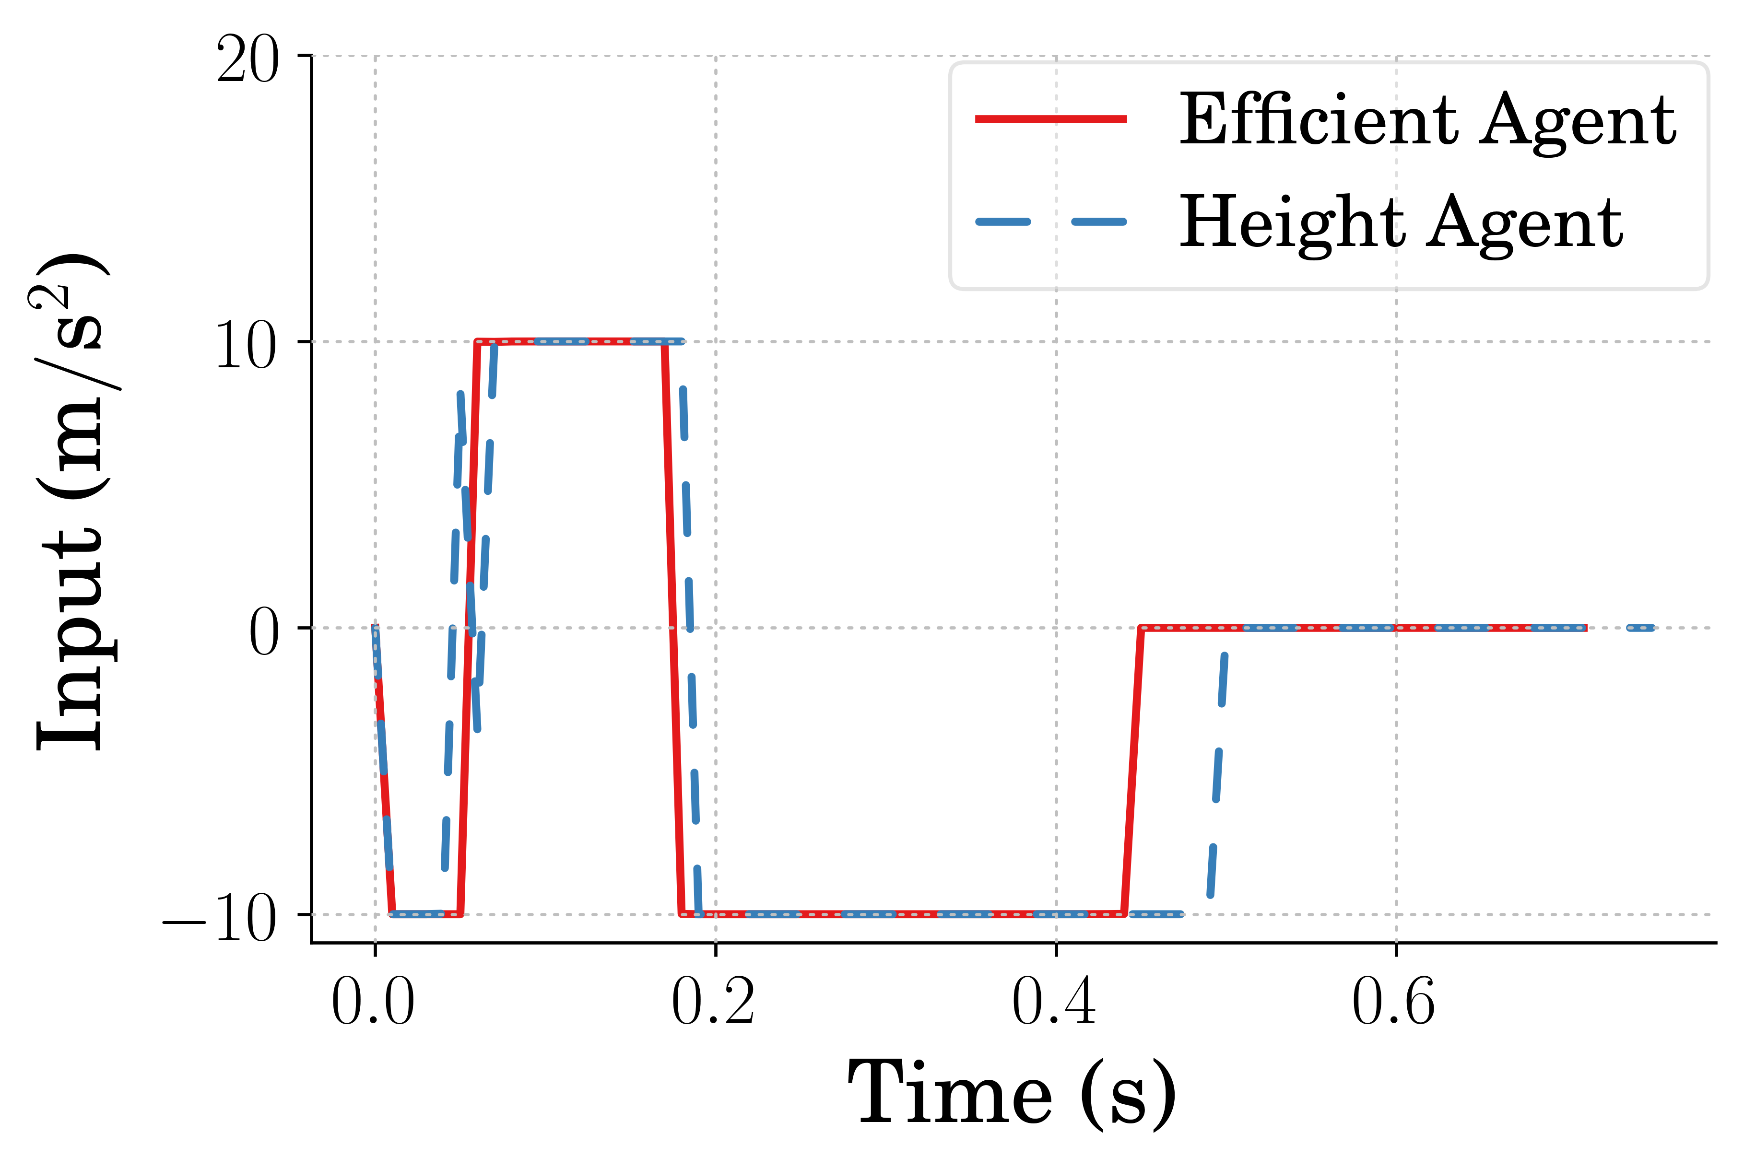
Single Jump Input
Notes:
Note:
Difference in timing for best agents
TODO:
What is a single jump?
Action? Observation?

Slide 13
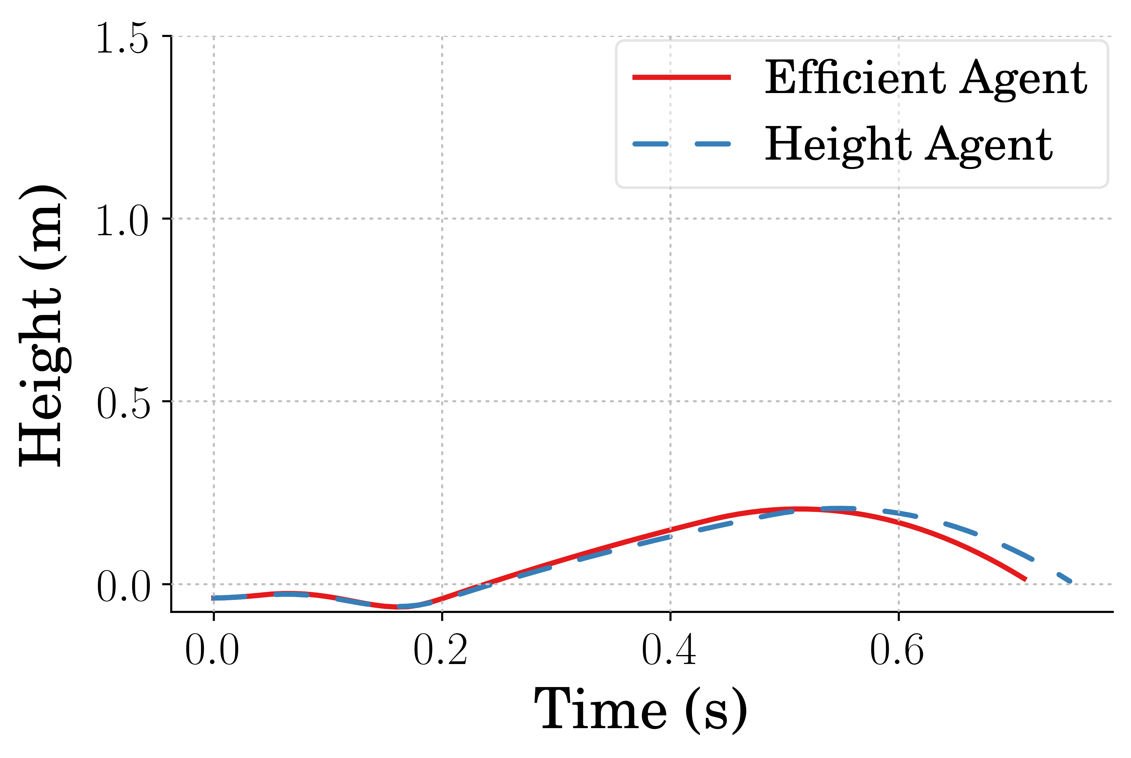
Single Jump Height Reached
Notes:
Note:
Best High agent jumped only 0.77% higher
0.61% higher average for high agent
0.76% higher max for high agent
17.91% more efficient average for the efficient agents
17.33% more efficient max for the efficient agent

Slide 14
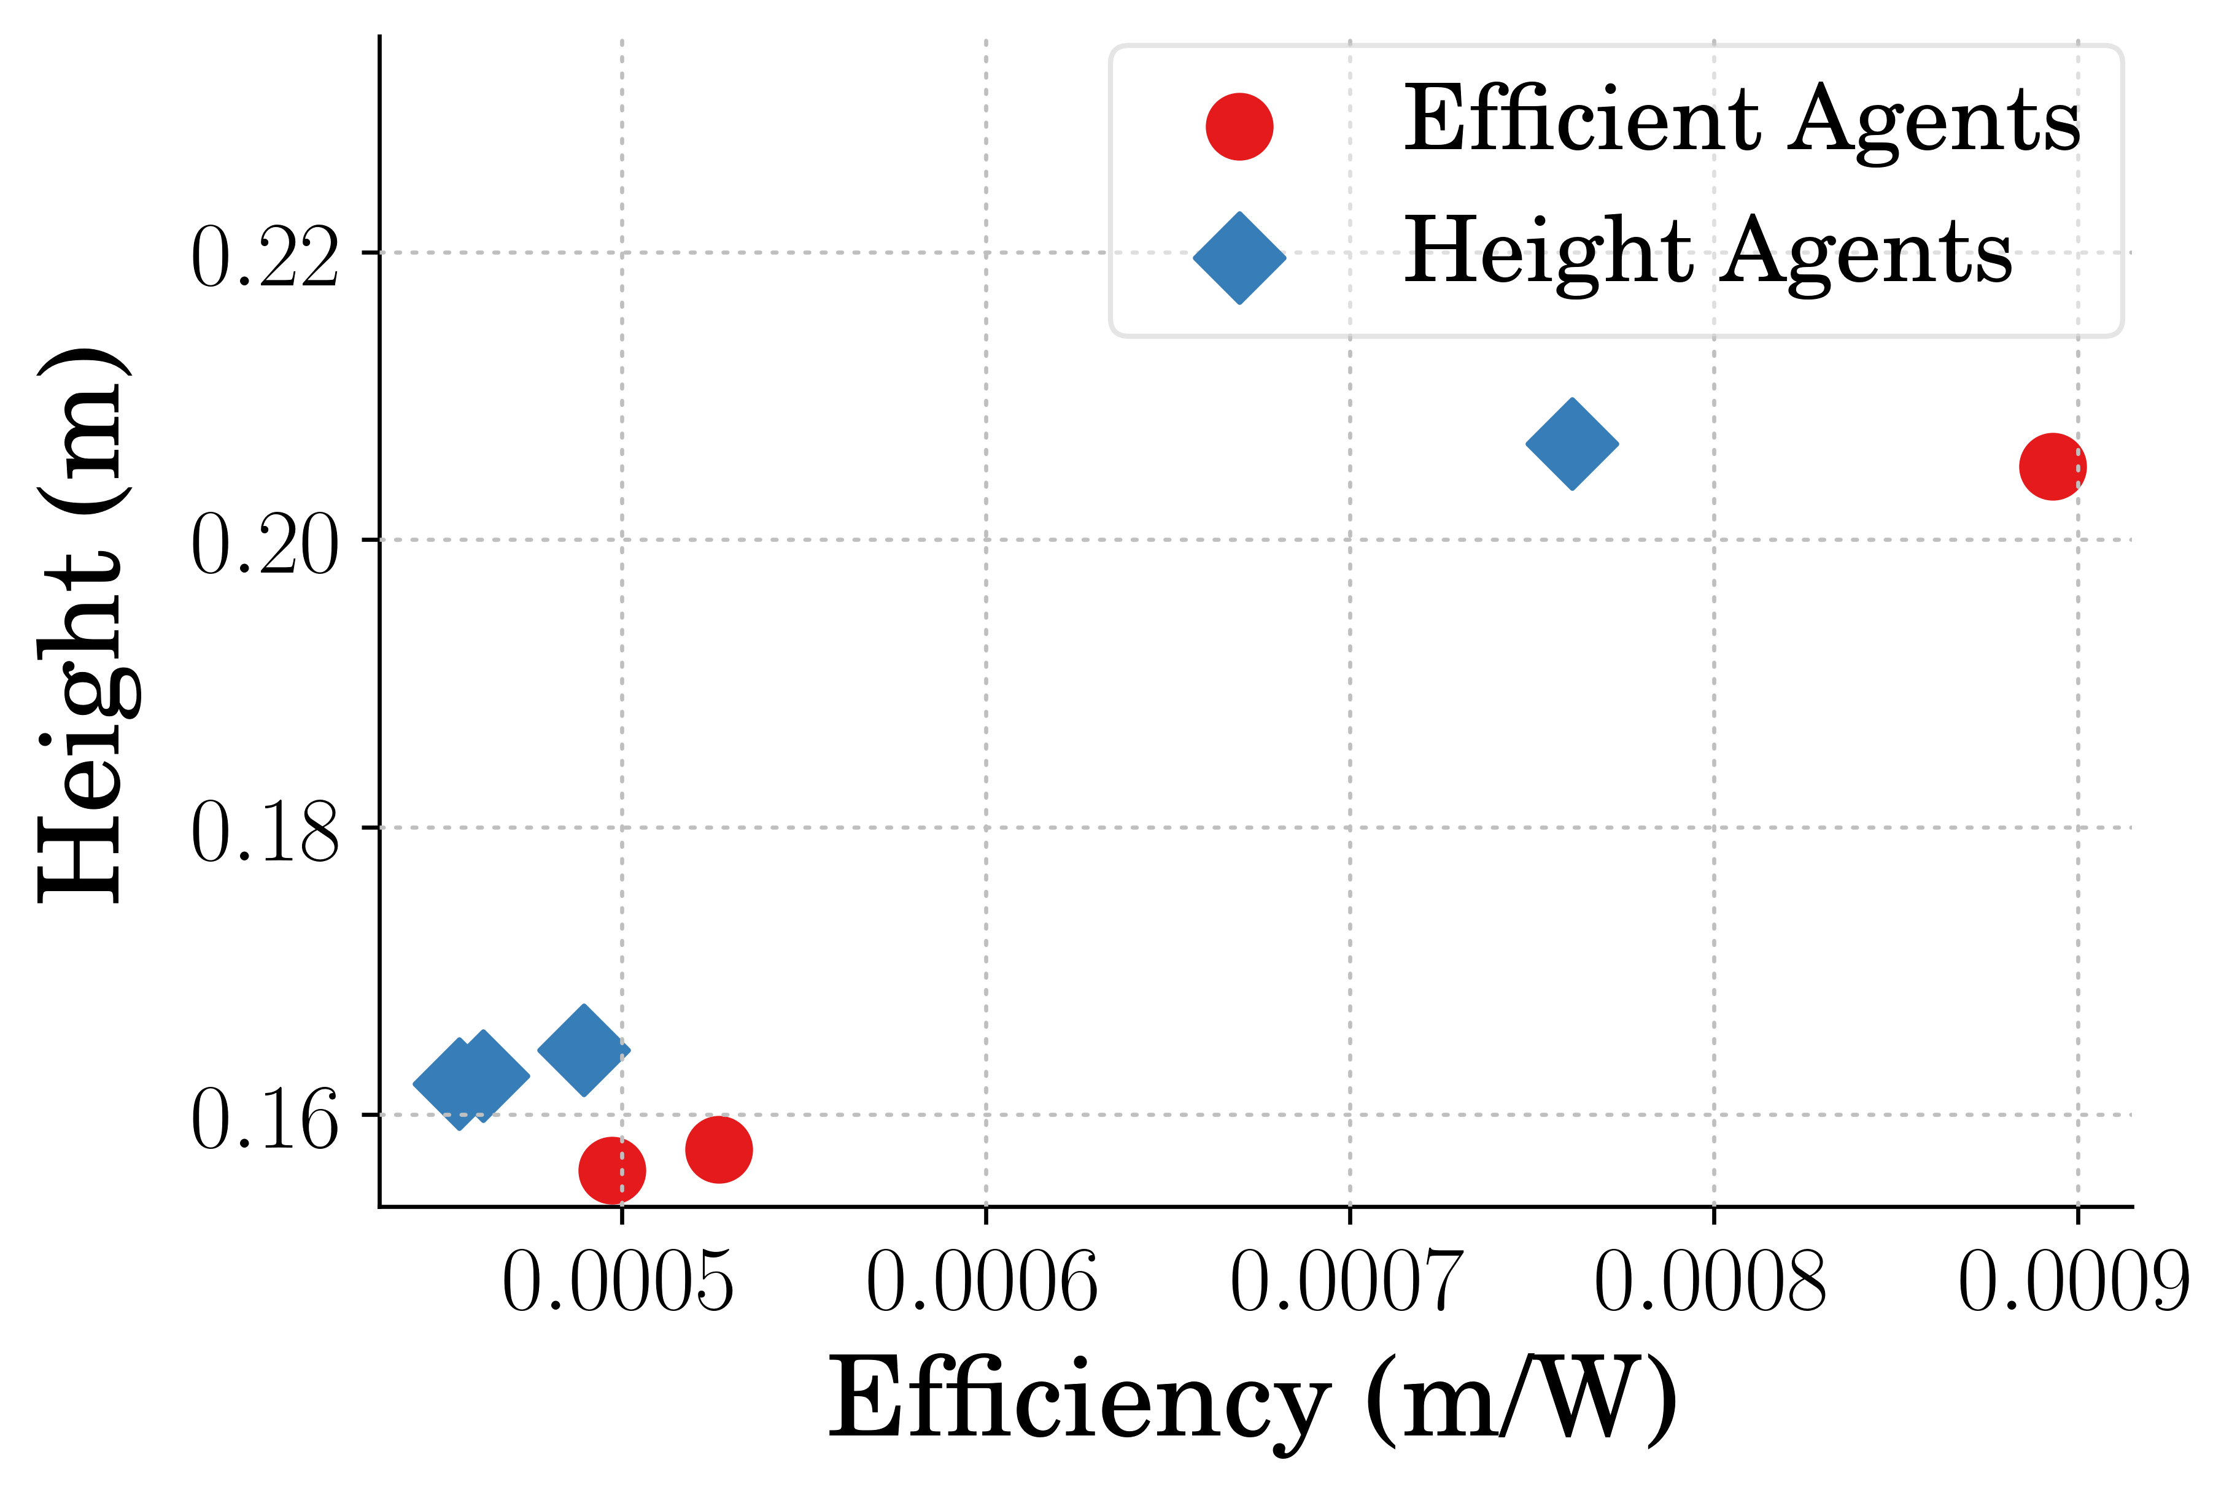
Single Jump Performance
Notes:
Note:
Best High agent jumped only 0.77% higher
0.61% higher average for high agent
0.76% higher max for high agent
17.91% more efficient average for the efficient agents
17.33% more efficient max for the efficient agent

Slide 15
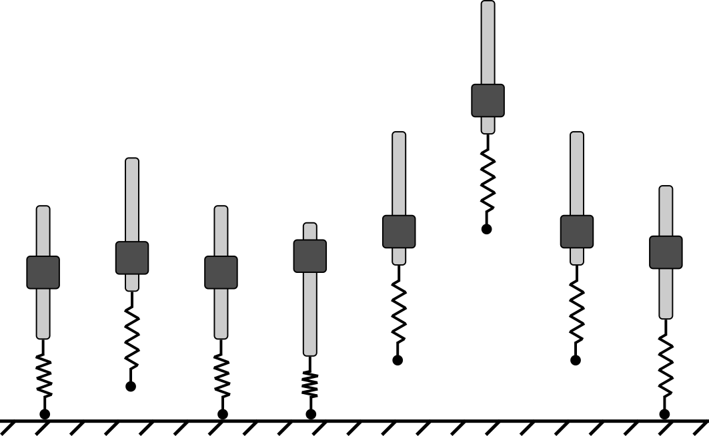
Stutter Jump
Notes:
Note:
- Difference in timing for best agents

Slide 16
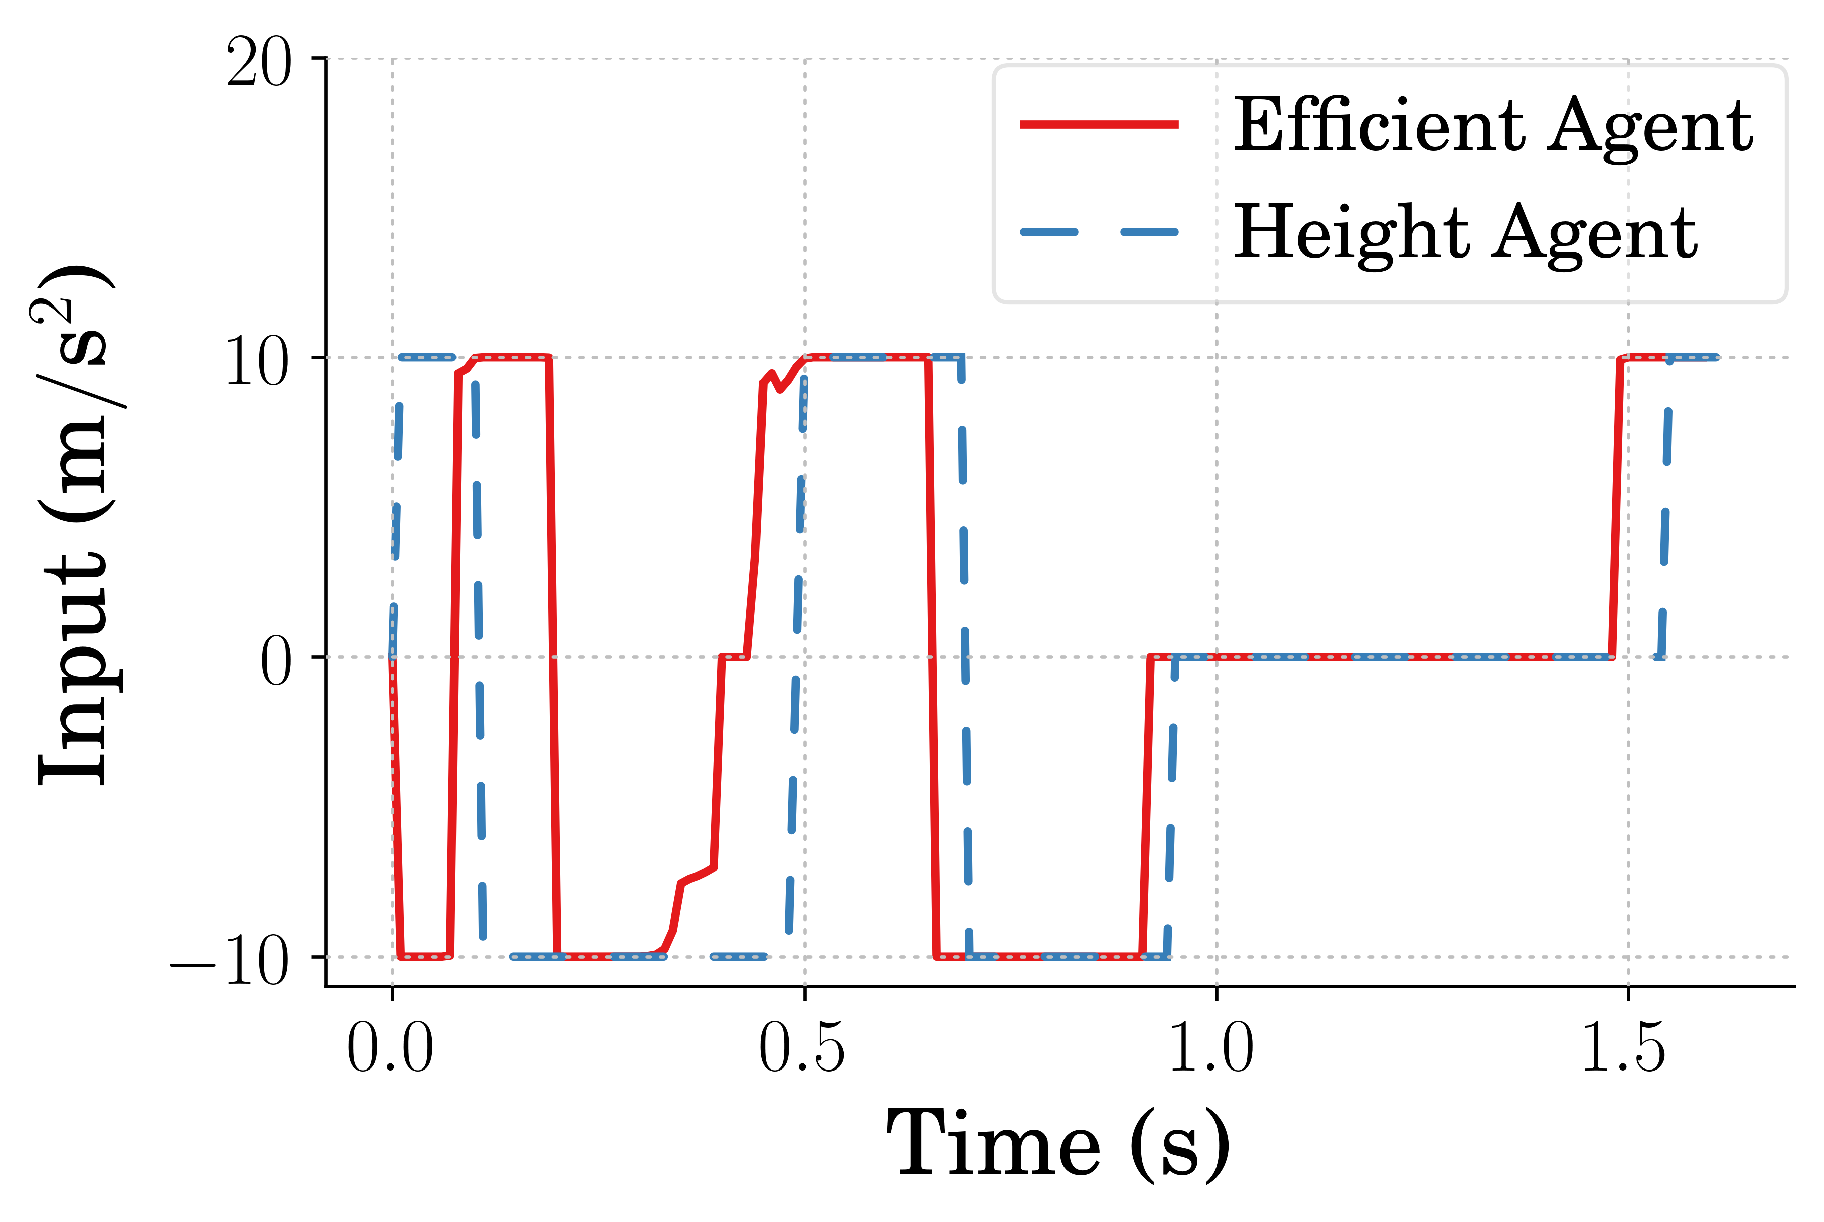
Stutter Jump Input
Notes:
Note:
- Difference in timing for best agents

Slide 17
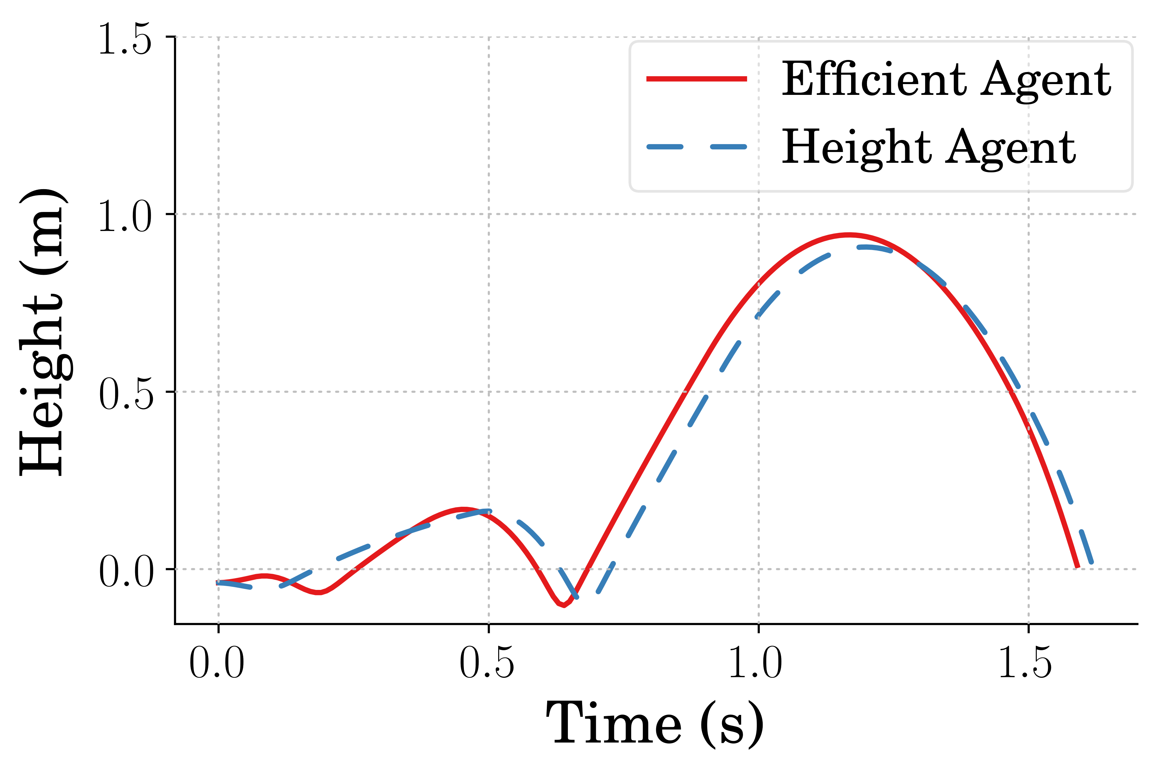
Stutter Jump Height
Notes:
Note:
Best Efficient agent jumped only 3.87% higher while also being 23.62% more efficient
2.22% higher average for eff agent
2.75% higher max for eff agent
10.56% more efficient average for the efficient agents
13.84% more efficient max for the efficient agent

Slide 18
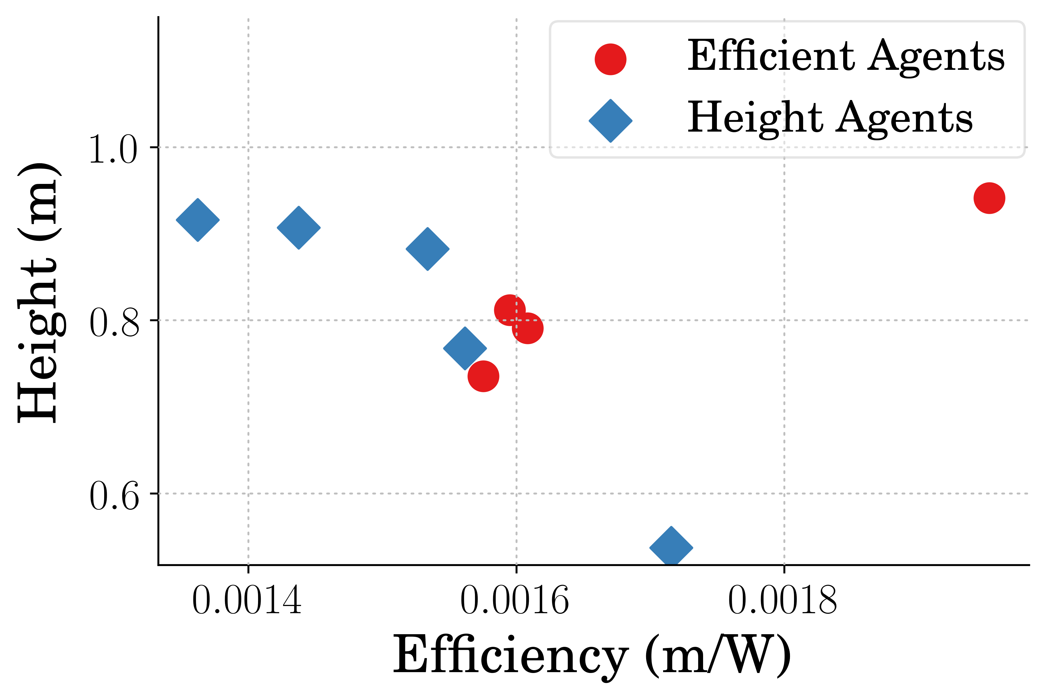
Stutter Jump Performance
Notes:
Note:
Best Efficient agent jumped only 3.87% higher while also being 23.62% more efficient
2.22% higher average for eff agent
2.75% higher max for eff agent
10.56% more efficient average for the efficient agents
13.84% more efficient max for the efficient agent

Slide 19
Conclusion
Reinforcement learning can be used to find control policies that are more efficient
Agents can learn efficient control where more complex control inputs are required
Controllers can be learned that are both higher in performance and efficient metrics

Slide 20
Thank you.

Slide 21
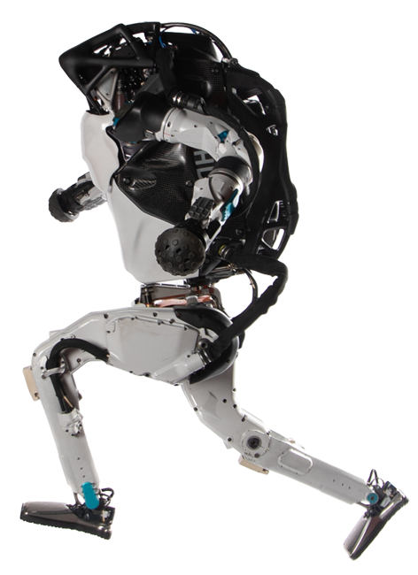
Legged & Flexible Robots
Pros
Ability to navigate uneven terrain
Different designs can be useful for different tasks
Can be designed to adapt to different terrain
Cons
Difficult to design stable controllers
Systems require high amounts of power
Difficult to design to overcome different obstacles
https://www.bostondynamics.com/atlas
Notes:
TODO:
Get citation

Slide 22
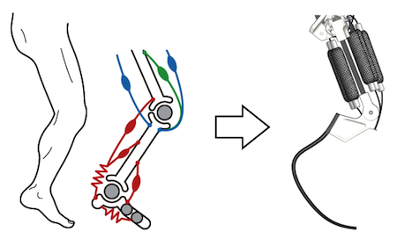
Legged & Flexible Robots
Pros
Increases in efficiency
Better stability through adaptability
Higher performance
Running speed
Jumping height
Cons
Difficult to define models for due to non-linearities
Challenging to create controllers for
Notes:
TODO:
Get citation

